Slide 1

Computer Club

Slide 2
What Is Computer Science?
can be seen as a science of problem solving, which requires precision, creativity, and careful reasoning

Slide 3
What Is Computer Science?
can be seen as a science of problem solving, which requires precision, creativity, and careful reasoning
is a discipline that spans theory and practice

Slide 4
What Is Computer Science?
can be seen as a science of problem solving, which requires precision, creativity, and careful reasoning
is a discipline that spans theory and practice
requires thinking both in abstract terms and in concrete terms

Slide 5
What Is Computer Science?
can be seen as a science of problem solving, which requires precision, creativity, and careful reasoning
is a discipline that spans theory and practice
requires thinking both in abstract terms and in concrete terms
requires intensive hands-on experience.

Slide 6
What Is Computer Science?
can be seen as a science of problem solving, which requires precision, creativity, and careful reasoning
is a discipline that spans theory and practice
requires thinking both in abstract terms and in concrete terms
requires intensive hands-on experience.
must also be able to design solutions and verify that they are correct.

Slide 7
What Is Computer Science?
has strong connections to other disciplines.

Slide 8
What Is Computer Science?
has strong connections to other disciplines.
Many problems in science, engineering, healthcare, business, and other areas can be solved effectively with computers, but finding a solution requires both computer science expertise and knowledge of the particular application domain.

Slide 9
What Is Computer Science?
has strong connections to other disciplines.
Many problems in science, engineering, healthcare, business, and other areas can be solved effectively with computers, but finding a solution requires both computer science expertise and knowledge of the particular application domain.
Thus, computer scientists often become proficient in other subjects.

Slide 10
CS in High School?
https://www.ncwit.org/resources/moving-beyond-computer-literacy-why-schools-should-teach-computer-science/moving-beyond
https://www.washingtonpost.com/local/education/high-school-students-are-all-about-computers-but-get-little-instruction-in-computer-science/2014/04/23/13979eda-c185-11e3-bcec-b71ee10e9bc3_story.html
https://techcrunch.com/2016/02/24/computer-science-is-now-a-high-school-graduation-requirement-in-chicagos-public-school-district/
http://cacm.acm.org/blogs/blog-cacm/156531-why-isnt-there-more-computer-science-in-us-high-schools/fulltext

Slide 11
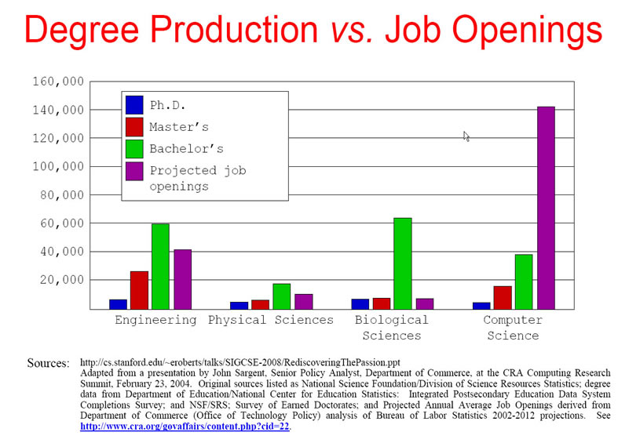
CS Job Openings

Slide 12
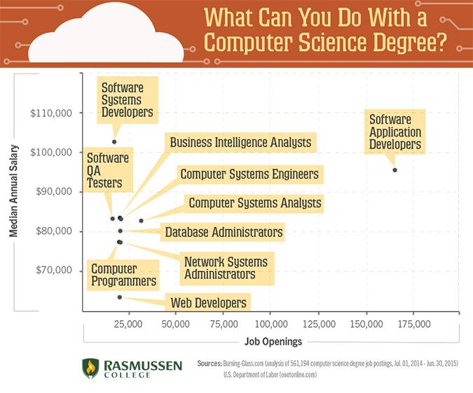
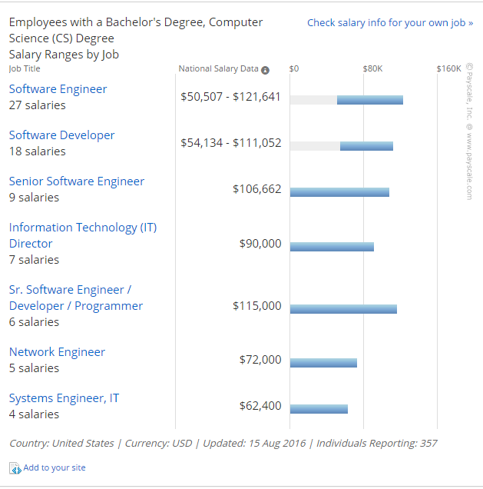
CS Job Salaries

Slide 13
Why You Should Be In the Computer Club?
Resume Builder

Slide 14




Why You Should Be In the Computer Club?
Resume Builder
Helps getting into a good college
I want all of you to get into TOP colleges

Slide 15
Why You Should Be In the Computer Club?
Resume Builder
Helps getting into a good college
I want all of you to get into TOP colleges
Easily pass AP Computer Science exam

Slide 16
Why You Should Be In the Computer Club?
Resume Builder
Helps getting into a good college
I want all of you to get into TOP colleges
Easily pass AP Computer Science
Potential internship and job opportunities (in highschool!)

Slide 17


Why You Should Be In the Computer Club?
Potential internship and job opportunities (in high school!)

Slide 18
Why You Should Be In the Computer Club?
Potential internship and job opportunities (in high school!)
Explore different career opportunities

Slide 19
Why You Should Be In the Computer Club?
Potential internship and job opportunities (in high school!)
Explore different career opportunities
Participate competitions

Slide 20
Why You Should Be In the Computer Club?
Potential internship and job opportunities (in high school!)
Explore different career opportunities
Participate competitions
For the sake of learning & challenging yourself

Slide 21
Why You Should Be In the Computer Club?
Potential internship and job opportunities (in high school!)
Explore different career opportunities
Participate competitions
For the sake of learning & challenging yourself
Self-motivation & time-management

Slide 22
Why You Should Be In the Computer Club?
Potential internship and job opportunities (in high school!)
Explore different career opportunities
Participate competitions
For the sake of learning & challenging yourself
Self-motivation & time-management
… to have fun

Slide 23
What Are We Going To Do?
Introduction to Programming

Slide 24


Introduction To Programming
Huge overlap with AP Computer Science A

Slide 25

What Are We Going To Do?
Introduction to Programming
Competitive Programming

Slide 26
Competitive Programming
Wiki Definition: "Competitive programming is a mind sport usually held over the Internet or a local network, involving participants trying to program according to provided specifications. Contestants are referred to as sport programmers."

Slide 27
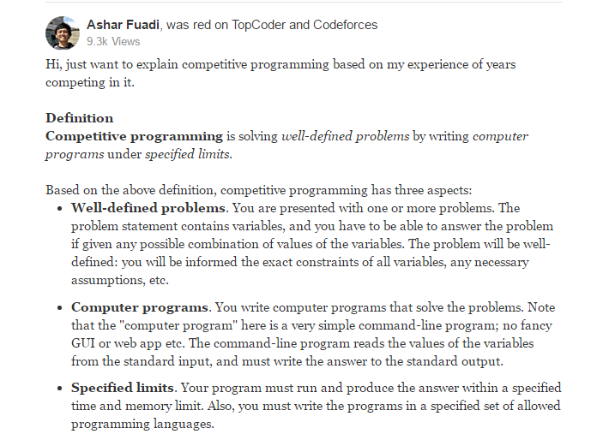
Competitive Programming

Slide 28

What Are We Going To Do?
Introduction to Programming
Competitive Programming
Cyber Security

Slide 29
Cyber Security
In the most general terms, security seems to mean something like “protection of assets against threats.”
What assets?
What kinds of threats?
What does “protection” mean?

Slide 30
Importance of Cyber Security
A recent study of 32,000 Websites found that nearly 97% of sites carry a severe vulnerability. – WebApplicationSecurity Consortium,Sept2008
“NSA found that inappropriate or incorrect software security conﬁgurations (most often caused by conﬁguration errors at the local base level) were responsible for 80 percent of Air Force vulnerabilities.”–CSIS report on Securing Cyberspace for the 44th Presidency,Dec.2008,p.55.

Slide 31
Importance of Cyber Security
A dozen determined computer programmer scan, if they ﬁnd a vulnerability to exploit, threaten the UnitedStates’ global logistics network, steal its operational plans, blind its intelligence capabilities or hinder its ability to deliver weapons on target.–William J. Lynn,U.S. Deputy Secy of Defense, ForeignAﬀairs(2010)
A top FBI oﬃcial warned today that many cyber-adversaries of the U.S. have the ability to access virtually any computer system, posing a risk that’s so great it could “challenge our country’s very existence.” –Computerworld, March 24,2010

Slide 32

Competitions
USACO
IOI
HP Code Wars

Slide 33


Competitions
USACO
IOI
HP Code Wars

Slide 34

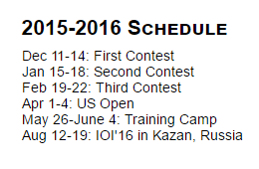
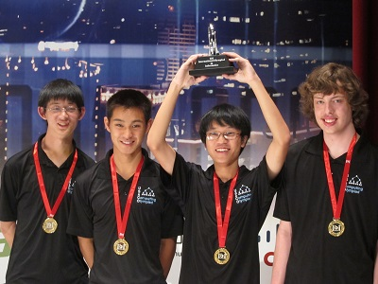
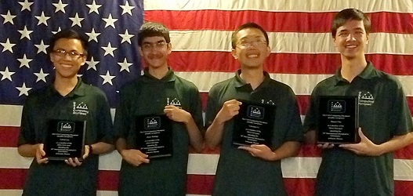
USACO
Platinum Division
Gold Division
Silver Division
Bronze Division
Top ~15 students are invited to camp
4 students are selected to the US team for the International Olympiads

Slide 35
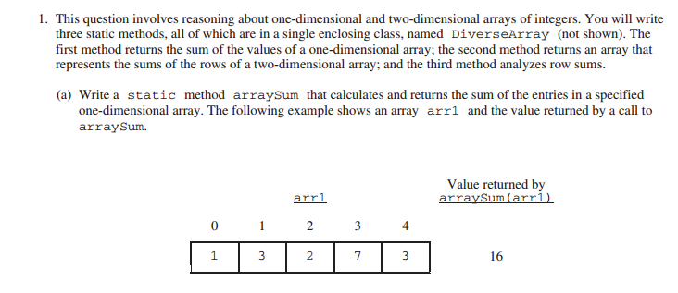
AP vs USACO: How Hard is It?
Here is a question and answer from AP Computer Science A exam:

Slide 36
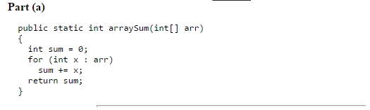
AP vs USACO: How Hard is It?
and the answer:

Slide 37
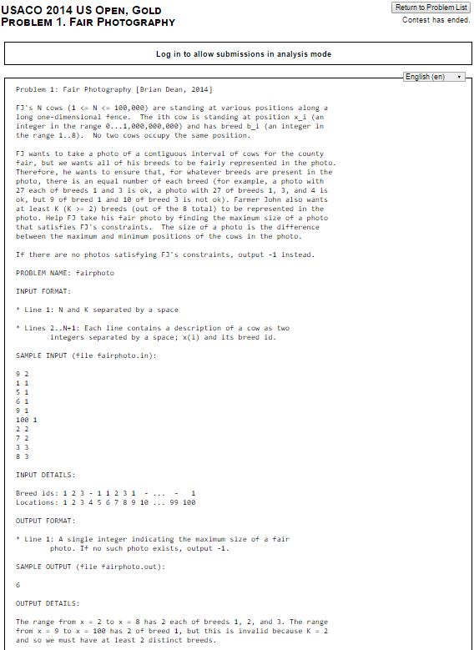
AP vs USACO
Here is a question
from USACO:

Slide 38
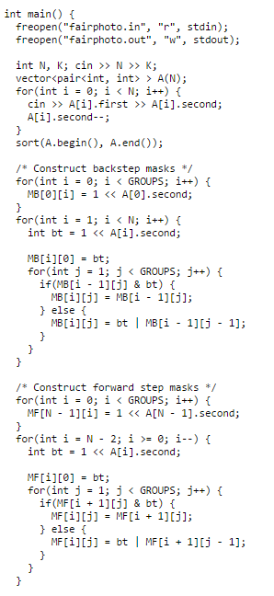
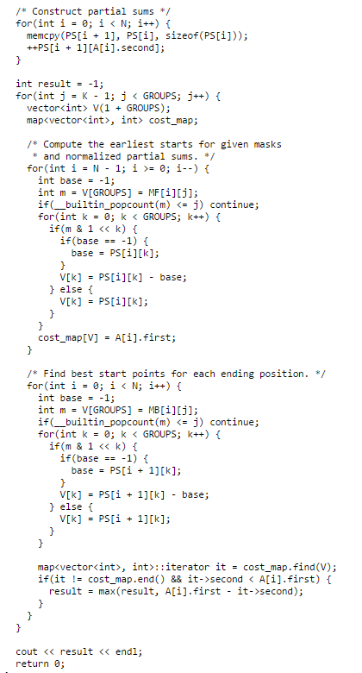
AP vs USACO
and the answer:

Slide 39

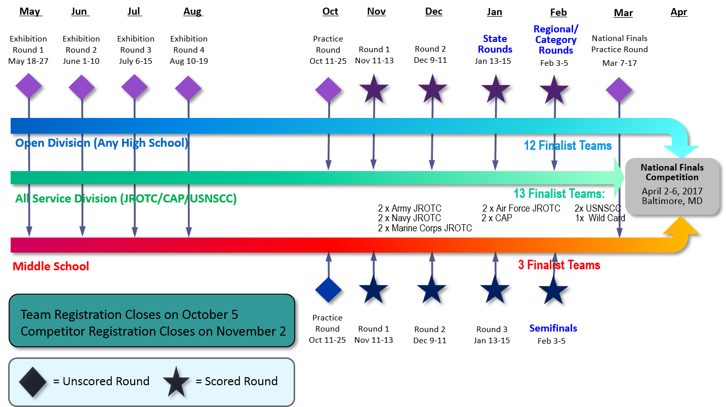
Cyber Patriots
6 students for each team
Number of teams will depend on YOU
https://www.youtube.com/watch?v=U1fXjlqXIEU
https://www.youtube.com/watch?v=JgRMOXE5KWU

Slide 40

How Are We Going To Study?
will meet twice a week at the beginning

Slide 41

How Are We Going To Study?
will meet twice a week at the beginning
study more as the competitions get closer
will have camps (probably)

Slide 42

How Are We Going To Study?
will meet twice a week at the beginning
study more as the competitions get closer
will have camps (probably)
might count toward congressional award!

Slide 43

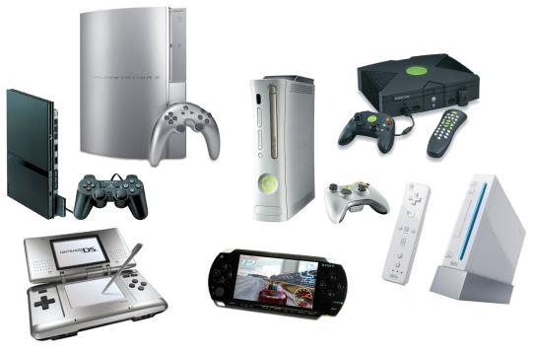
Fun Time -- Possible Activities
Movie Nights
Game Nights
Soccer/Basketball
Field Trips

Slide 44

HOMEWORK!!!
is important

Slide 45
HOMEWORK!!!
is important
3 parts of homework:
short video for next lecture
multiple choice & short answer questions
programming

Slide 46
HOMEWORK!!!
is important, duh!
3 parts of homework:
short video for next lecture
multiple choice & short answer questions
programming
some questions will require to use google
researching & teaching yourself is important

Slide 47
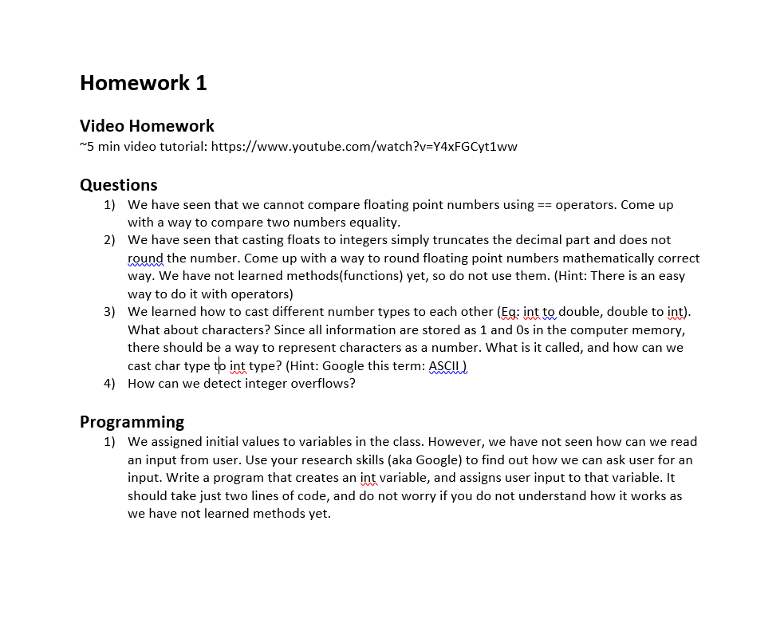
HOMEWORK!!!
Example Hw:

Slide 48
What Do You Need?
Required:
Curiosity & Passion For Learning & To Challenge Yourself

Slide 49
What Do You Need?
Required:
Curiosity & Passion For Learning & To Challenge Yourself
Highly Recommended:
Laptop

Slide 50
What Do You Need?
Required:
Curiosity & Passion For Learning & To Challenge Yourself
Highly Recommended:
Laptop
Recommended:
Background in math & programming

Slide 51
What Do You Need?
Required:
Curiosity & Passion For Learning & To Challenge Yourself
Highly Recommended:
Laptop
Recommended:
Background in math & programming
Optional:
Notebook

Slide 52
What About Textbook?
The internet is your textbook
Google is your friend
If you think you need one, then any Java book should be fine

Slide 53
Rules
Common sense rules

Slide 54
Rules
Common sense rules
Attendance is REQUIRED & IMPORTANT

Slide 55
Rules
Common sense rules
Attendance is REQUIRED & IMPORTANT
Homework needs to be turned in before it's due

Slide 56
Rules
Common sense rules
Attendance is REQUIRED & IMPORTANT
Homework needs to be turned in before it's due
Disruptive & Inappropriate behavior (physical/verbal violence to classmates, unnecessary & excessive talking etc... ) will NOT be tolerated

Slide 57
Rules
Common sense rules
Attendance is REQUIRED & IMPORTANT
Homework needs to be turned in before it's due
Disruptive & Inappropriate behavior (physical/verbal violence to classmates, unnecessary & excessive talking etc... ) will NOT be tolerated
Verbal warning for the first (few) violation (depends on the violation)

Slide 58
Rules
Common sense rules
Attendance is REQUIRED & IMPORTANT
Homework needs to be turned in before it's due
Disruptive & Inappropriate behavior (physical/verbal violence to classmates, unnecessary & excessive talking etc... ) will NOT be tolerated
Verbal warning for the first (few) violation (depends on the violation)
If it continues, then the student cannot continue to study with us

Slide 59
Rules
Common sense rules
Attendance is REQUIRED & IMPORTANT
Homework needs to be turned in before it's due
Disruptive & Inappropriate behavior (physical/verbal violence to classmates, unnecessary & excessive talking etc... ) will NOT be tolerated
Verbal warning for the first (few) violation (depends on the violation)
If it continues, then the student cannot continue to study with us
ALL HPS STUDENT HANDBOOK RULES APPLY

Slide 60
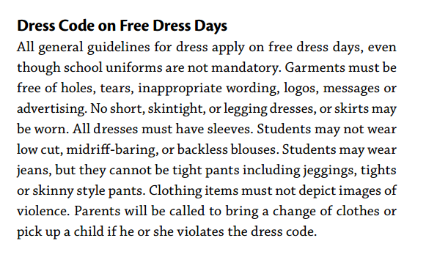
Dress Code
Treat it as a free dress day (the excerpt is from HPS student handbook)

Slide 61
Dress Code
Treat it as a free dress day (the excerpt is from HPS student handbook)
do not need school uniform (still need to confirm it)

Slide 62
Dress Code
Treat it as a free dress day (the excerpt is from HPS student handbook)
do not need school uniform (still need to confirm it)
You are future leaders, dress accordingly

Slide 63
Expectation From Parents
Tracking
Parent chaperones for field trips
Communication
Email: hsanacomputerclub@gmail.com
Email2: tarikozkaya@utexas.edu / ozkaya.tarik@gmail.com
Phone: 832 367 1224

Slide 64

Canvas

